Slide 1
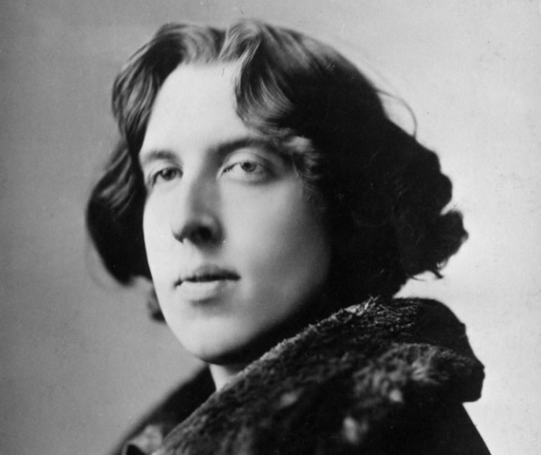
The Importance of Being Earnest
By Oscar Wilde

Slide 2
Biography:
Oscar Fingal O’Flahertie Wills Wilde was an Anglo-Irish playwright, novelist, poet, and critic. He is regarded as one of the greatest playwright of the Victorian Era. He was born on 16 October, 1854 in Ireland.
In his early 1890’s, he became one of the most popular play write in London. In his lifetime he wrote nine plays, one Novel, and numerous poems, short stories, and essays.
Wilde was a proponent of the Aesthetic movement, which emphasized aesthetic values more than moral or social themes. This doctrine is most clearly summarized in the phrase 'art for art's sake’.
He was imprisoned for his homosexual relationship with the son of an aristocrat.
Oscar Wilde was known for his acclaimed works including 'The Picture of Dorian Gray' and 'The Importance of Being Earnest’.
Wilde died of meningitis on November 30, 1900, at the age of 46.

Slide 3
Introduction:
The importance of being earnest is a comic play written by Oscar Wilde. It was first performed in 14 February, 1895 at the St. James’s Theater in London.
It is a farcical comedy in which the protagonists maintain fictitious personae to escape burdensome social obligations.
The play’s protagonists is Jack Worthing, seemingly responsible and respectable young man who leads a double life.
Jack and Algernon attempts to win the heart of two women.
Wilde uses satire to ridicule the cultural norms of marriage love and mind-set which were very rigid during the Victorian Age.

Slide 4
Main Idea:
In The Importance of Being Earnest, the upper classes care about being respectable so much so that they do a lot of lying about it.
Jack's conflict with his identity: He has to decide on who he wants to be. He can either be Earnest and live the fast city life and marry Gwendolen, but be a liar. Or he can tell the truth and be rejected by the love of his life, but live a simple life in the country with his family.
Algernon thinks the servant class has a responsibility to set a moral standard for the upper classes. What Wilde wants us to see as truly moral is really the opposite of earnestness: irreverence.
Jack and Algernon are wealthy gentlemen. Jack (known to Algernon as Ernest) lives a respectable life in the country providing an example to his young ward Cecily. Jack wants to marry Algernon's cousin Gwendolen, but must first convince her mother, Lady Bracknell, of the respectability of his parents.

Slide 5
Themes:
Respect and reputation
Lies and deceit
Society and class
Foolishness and folly
Marriage
Irony
Seriousness and determination
Morality
Identity

Slide 6
Characters:
Jack Worthing: A young gentleman from the country, in love with Gwendolen Fairfax.
Algernon Moncrieff: A young gentleman from London, the nephew of Lady Bracknell, in love with Cecily Cardew.
Gwendolen Fairfax: A young lady, loved by Jack Worthing.
Lady Bracknell: A society lady, Gwendolen’s mother.
Cecily Cardew: A young lady, the ward of Jack Worthing.
Miss Prism: governess

Slide 7
Conclusion:
At the end of the story, they become two young couples united by the name Earnest. This Drama mocks the lifestyle of high class in the Victorian Era which focuses on wealth and material thing. Meanwhile, the gender roles are reversed. The Male possess the traditional stereotype of female, such as playing piano and eating sandwiches and muffins without doing productive things. The females, on the contrary, show strong will and aggression.

